Slide 1
Chapter 1
INTRODUCTION
Cios / Pedrycz / Swiniarski / Kurgan

Slide 2
Syllabus
– Textbook(s):
Data Mining: A Knowledge Discovery Approach” by Cios et al., Springer, 2007
– Class Schedule:
Lecture: MW 11-12:15pm, Bldg. West Eng., Room 105
Lab: , Bldg. , Room
– Evaluation:
General Instructions:
To succeed in the course
Attend and participate in all classes
Be prepared to spend a few hours per week outside of the classroom, in addition to the classroom time
Keep up with the assigned readings, homeworks and projects
Late submission:
Projects and homeworks, both electronic and hard copy, must be turned in by the beginning of class on the due date
Submissions turned-in within 24 hours from the due date will receive a 15% penalty, and those over 24 hours will receive a 40% penalty
Grading:
Midterm exams (2) 44% (22% each)
Project (including 5% for project progress report) 30%
Class activity/discussion 4%
Homework 22%
© 2007 Cios / Pedrycz / Swiniarski / Kurgan

Slide 3
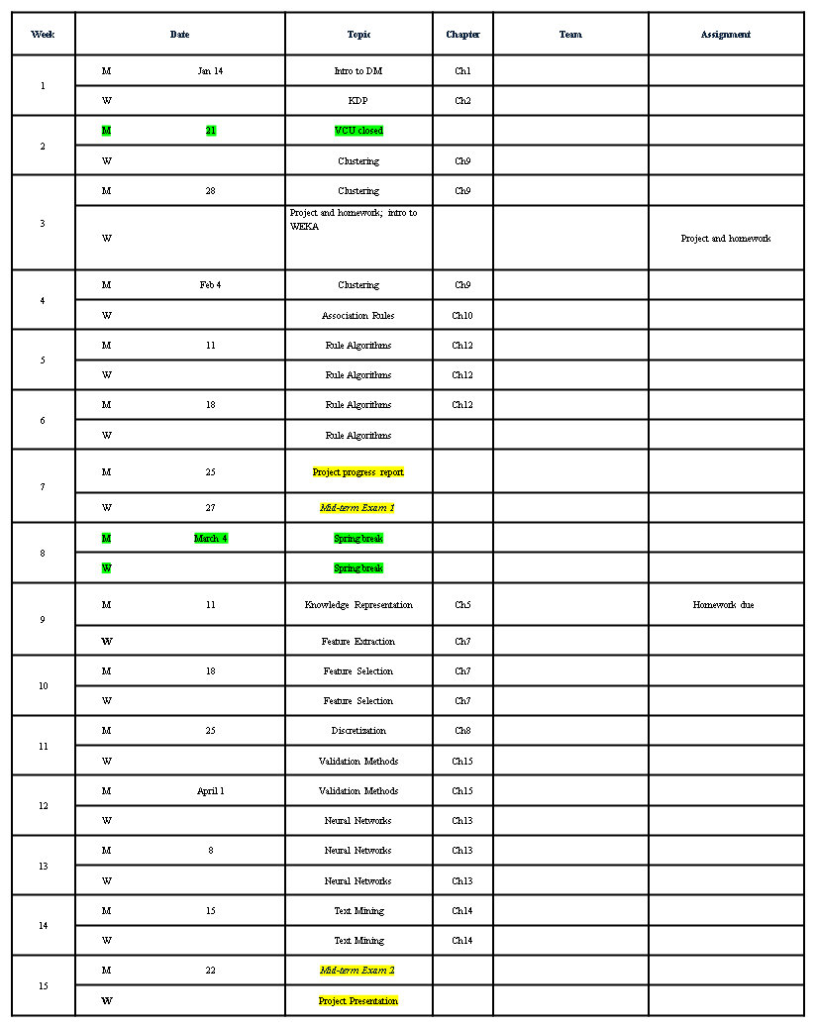
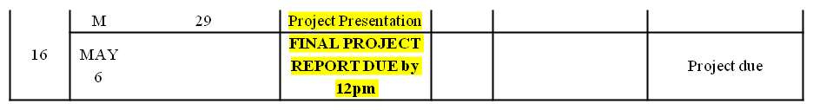

Slide 4
Outline
What is Data Mining
  www.kdnuggets.com
  This web site is by far the best source of information about all aspects of DM.
How does Data Mining differ from other approaches?
© 2007 Cios / Pedrycz / Swiniarski / Kurgan

Slide 5
Introduction
The aim of data mining is
1) to make sense of
2) large amounts of
3) mostly unsupervised data, in some
4) domain
© 2007 Cios / Pedrycz / Swiniarski / Kurgan

Slide 6
Introduction
1) to make sense
we envision that new knowledge should exhibit a series of essential attributes:
be understandable
valid
novel
useful
© 2007 Cios / Pedrycz / Swiniarski / Kurgan

Slide 7
Introduction
1) to make sense
the most important requirement is that the discovered new knowledge needs to be
understandable to data owners
who want to use it to their advantage
© 2007 Cios / Pedrycz / Swiniarski / Kurgan

Slide 8
Introduction
1) to make sense
a model that is easy-to-understand is highly preferable, for instance when using rules of the form:
IF abnormality (obstruction) in coronary arteries
THEN coronary artery disease
© 2007 Cios / Pedrycz / Swiniarski / Kurgan

Slide 9
Introduction
1) to make sense
the second important requirement is that the discovered new knowledge should be valid
If all the generated rules were already known they would be of no interest
(although in model building generation of the already-known rules validates the generated model)
© 2007 Cios / Pedrycz / Swiniarski / Kurgan

Slide 10
Introduction
1) to make sense
the other requirement is that the discovered knowledge must be novel
If the knowledge about how to diagnose a patient had been discovered not in terms of rules but, say, using a neural network (“black box”) then this knowledge may or may not be acceptable.
However, a trained NN might be acceptable if it were proven to work well on hundreds of new cases / have good predictive power.
© 2007 Cios / Pedrycz / Swiniarski / Kurgan

Slide 11
Introduction
1) to make sense
Another requirement is that the discovered new knowledge must be useful
Usefulness must hold true regardless of the type of model used.
© 2007 Cios / Pedrycz / Swiniarski / Kurgan

Slide 12
Introduction
2) large amounts
DM is about analyzing large amounts of data that cannot be dealt with by manual analysis.
© 2007 Cios / Pedrycz / Swiniarski / Kurgan

Slide 13
Introduction
2) large amounts
AT&T handles over 300 million calls daily to serve about 100 million customers and stores the information in a multiterabyte database
Wal-Mart, in its stores handles well over 20 million transactions a day, and stores the information in a database of about a dozen terabytes
NASA generates several gigabytes of data per hour through its Earth Observing System
Homeland Security is collecting petabytes of data on its own and other countries’ citizens.
© 2007 Cios / Pedrycz / Swiniarski / Kurgan

Slide 14
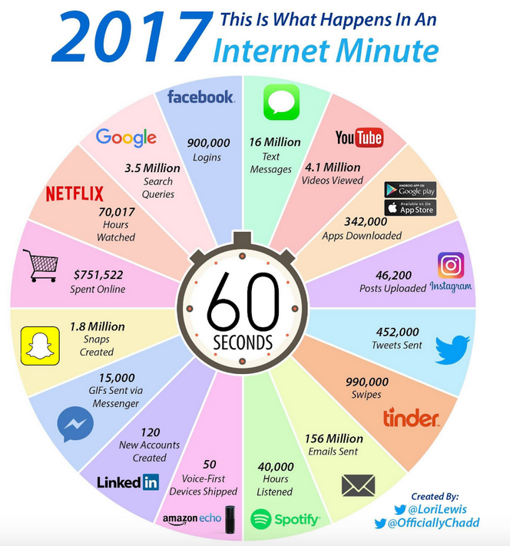
+ big biological (genomic, proteomic) data
+ big IoT data
+…

Slide 15
Introduction
3) mostly unsupervised data
It is much easier, and far less expensive, to collect unsupervised than supervised data.
As for supervised data we must know inputs and corresponding outputs - determined by domain experts.
© 2007 Cios / Pedrycz / Swiniarski / Kurgan

Slide 16
Introduction
3) mostly unsupervised data
What can we do if only unsupervised data are collected?
We use algorithms that are able to find “natural” groupings/clusters or relationships/associations in the data.
If clusters are found they can be labeled by domain experts. In the latter case unsupervised data becomes supervised, and the problem becomes much easier.
© 2007 Cios / Pedrycz / Swiniarski / Kurgan

Slide 17
Introduction
3) mostly unsupervised data
What if data are semi-supervised, meaning that there are a few known input-output data pairs along with thousands of unsupervised data points?
These few data points should help in trying to make sense of the entire data set.
Techniques using them are called
semi-supervised
example is partially supervised clustering.
© 2007 Cios / Pedrycz / Swiniarski / Kurgan

Slide 18
Introduction
3) mostly unsupervised data
A DM algorithm that works well on both small and large data is called
scalable
unfortunately few are.
© 2007 Cios / Pedrycz / Swiniarski / Kurgan

Slide 19
Introduction
4) domain
The success of DM projects depends heavily on access to domain knowledge and experts.
Discovering new knowledge is a highly
interactive (with domain experts)
and
iterative (within knowledge discovery steps) process.
We cannot simply take a successful DM system, built for some domain,
and apply it to another domain and expect good results!
© 2007 Cios / Pedrycz / Swiniarski / Kurgan

Slide 20
Introduction
This book is about making sense of data.
Its goal is to provide readers with the fundamentals of frequently used DM methods and to provide guidance for doing DM projects:
from understanding the problem and the data,
through preprocessing the data,
to building models and
validating them
to putting the newly discovered knowledge to use.
© 2007 Cios / Pedrycz / Swiniarski / Kurgan

Slide 21
How does Data Mining Differ from Other Approaches?
Data mining came into existence because of technological advances in many disciplines:
Computer Engineering contributed to the development of more powerful computers in terms of speed and memory;
Computer Science and Mathematics developed more efficient database architectures and search algorithms;
combination of these disciplines helped to develop the World Wide Web (WWW).
© 2007 Cios / Pedrycz / Swiniarski / Kurgan

Slide 22
How does Data Mining Differ from Other Approaches?
Along with dramatic increase in the amount of stored data came demands for
better, faster and cheaper ways to deal with them.
Simply stated:
all the data in the world are of no value without mechanisms to efficiently and effectively extract
information/knowledge from them.
© 2007 Cios / Pedrycz / Swiniarski / Kurgan

Slide 23
How does Data Mining Differ from Other Approaches?
Early DM pioneers:
U. Fayyad
H. Mannila
G. Piatetsky-Shapiro
G. Djorgovski
W. Frawley
P. Smith
many others…
© 2007 Cios / Pedrycz / Swiniarski / Kurgan

Slide 24
How does Data Mining Differ from Other Approaches?
Data mining is not just an “umbrella” term coined for the purpose of making sense of data.
The major distinguishing characteristic of DM is that it is data driven, as opposed to other methods that are often model driven.
In statistics, researchers deal with the problem of finding the smallest data size that gives sufficiently confident estimates.
In DM, we deal with the opposite problem, namely, data size is large and we strive to build a data model that is small (not too complex) but still describes the data well.
© 2007 Cios / Pedrycz / Swiniarski / Kurgan

Slide 25
How does Data Mining Differ from Other Approaches?
Finding a good model of the data, which at the same time is easy to understand, is at the heart of DM.
We need to keep in mind that none of the generated models will be complete
(using all the relevant variables/attributes of the data),
and that almost always we look for a compromise between model completeness and model complexity.
© 2007 Cios / Pedrycz / Swiniarski / Kurgan

Slide 26
How does Data Mining Differ from Other Approaches?
Word of caution:
although many commercial, as well as open-source DM tools exist they do not produce automatic results, in spite of the vendors hype about them.
We should remember that the application of even a very good tool to one’s data will most often not result in the generation of valuable knowledge after simply clicking “run”and getting some result.
© 2007 Cios / Pedrycz / Swiniarski / Kurgan

Slide 27
How to Use this Book for a Course on Data Mining?
The core elements of the book, which we will cover in depth, are:
data preprocessing methods,
described in Part III,
model building, described in Part IV and
model assessment, covered in Part V.
For hands-on experience you will mine in real data set and follow the knowledge discovery process.
© 2007 Cios / Pedrycz / Swiniarski / Kurgan

Slide 28
Tukey’s Advice
From The Collected Works of John W. Tukey: Philosophy and Principles, Volume 3. Many of the "badmandments" are just as relevant to today's data scientists:
The Great Badmandment restated:
ONLY THREE ACTIONS IN SCIENCE ARE SAFE:
TO BE GUIDED BY THEORY, any theory;
TO BE SIMPLE, and
to do NOTHING, absolutely nothing
1. THERE IS NO ANALYSIS LIKE UNTO CROSS-TABULATION
2. BE EXACTLY WRONG, RATHER THAN APPROXIMATELY RIGHT
3. THE ONE AND ONLY PROPER USE OF STATISTICS IS FOR SANCTIFICATION (we used statistics, our work is above criticism!)
4. BEWARE EMPIRICISM, IT ISN'T SCIENTIFIC
© 2007 Cios / Pedrycz / Swiniarski / Kurgan

Slide 29
Tukey’s Advice
Other BADMANDMENTS:
91. NEVER plan any analysis before seeing the DATA.
92. DON'T consult with a statistician until after collecting your data
94. LARGE enough samples always tell the truth
96. NEVER try to find out if your population is meaningfully divided into two or more subpopulations
97. ANY one regression (model) will tell you what you want to know, don't even think of looking at MORE.
100. The significance level tells you the probability that your result is WRONG.
© 2007 Cios / Pedrycz / Swiniarski / Kurgan

Slide 30
Bonferroni’s Principle
BP example is taken from “Mining of Massive Datasets” by Leskovec, Rajaraman and Ullman, Stanford Univ., 2014
Bonferroni’s principle helps to avoid finding artifacts in the data versus something what is truly there.
In other words, it avoids finding random occurrences in data.
BP outline:
Calculate the expected number of occurrences of the events you are looking for, on the assumption that data are random.
If this number is significantly larger than the number of real instances you hope to find, then almost anything you find will be an artifact.
© 2007 Cios / Pedrycz / Swiniarski / Kurgan

Slide 31
Bonferroni’s Principle
Suppose there are some “bad people” out there, and we want to detect them.
Also suppose that periodically they get together at a hotel to plot something bad.
Example assumptions:
1. There are one billion people who might be bad.
2. Everyone goes to a hotel one day in 100.
3. A hotel holds 100 people. There are 100,000 hotels – enough to hold 1% of a billion people who visit a hotel on any given day.
4. We examine hotel records for 1000 days.
© 2007 Cios / Pedrycz / Swiniarski / Kurgan

Slide 32
Bonferroni’s Principle
To find bad people we look for people who on two different days, were both at the same hotel.
Suppose, however, that everyone behaves at random, deciding with probability 0.01 to visit a hotel on any given day, choosing one of the 100,000 hotels at random.
Can we find pairs of people who appear to be bad?
© 2007 Cios / Pedrycz / Swiniarski / Kurgan

Slide 33
Bonferroni’s Principle
The probability of any two people both deciding to visit a hotel on any given day is .0001.
The chance that they will visit the same hotel is this probability divided by 100K (# of hotels). Thus, the chance that they will visit the same hotel on one given day is
The chance that they will visit the same hotel on two different given days is
For large n, (n over 2) is about
Thus, the number of pairs of people is ( over 2) = 5 ×
The number of pairs of days is (1000 over 2)= 5 ×
© 2007 Cios / Pedrycz / Swiniarski / Kurgan

Slide 34
Bonferroni’s Principle
The number of events that look like evil-doing is the product of the number of pairs of people, the number of pairs of days, and the probability that any one pair of people and pair of days is an instance of the behavior we are looking for. That number is
5 × × 5 × × = 250,000
So there are a quarter of a million pairs of people who look like bad people but are not.
Now, suppose there really are 10 pairs of bad people out there.
So the police would need to investigate 250K pairs of people in order to find the real bad people!
© 2007 Cios / Pedrycz / Swiniarski / Kurgan

Slide 35
How to compensate for BP?
From Wikipedia
The look-elsewhere effect is a phenomenon in the statistical analysis of experiments
where an apparently statistically significant observation may have actually arisen by chance because of the sheer size of the parameter space to be searched.
© 2007 Cios / Pedrycz / Swiniarski / Kurgan

Slide 36
How to compensate for BP?
If one is performing multiple tests ("looking elsewhere" if the first test fails)
then a p value of 1/n is expected to occur after about n tests.
Example: when there is no real effect, an event with p < 0.05 will on average still be seen after 20 tests.
This is a simplified case;
the number n is actually the number of degrees of freedom in the tests,
or the number of effectively independent tests.
© 2007 Cios / Pedrycz / Swiniarski / Kurgan

Slide 37
How to compensate for BP?
The Bonferroni correction compensates for that increase by testing each individual hypothesis at a significance level of α / n, where α is the desired overall alpha level and n is the number of hypotheses.
For example,
if a trial is testing n = 20 hypotheses with a desired α = 0.05, then the Bonferroni correction would test each individual hypothesis at α = 0.05 / 20 = 0.0025
© 2007 Cios / Pedrycz / Swiniarski / Kurgan

Slide 38
Degree of Freedom
The number of independent pieces of information necessary to estimate the parameters of a model.
Example:
The sample mean has one degree of freedom.
© 2007 Cios / Pedrycz / Swiniarski / Kurgan

Slide 39
Degree of Freedom
A robot arm has 7 degrees of freedom as follows:
Shoulder motion, is called pitch (up and down) or yaw (left and right)
Elbow motion is a pitch
Wrist motion can be pitch or yaw
Rotation (roll) is possible for both wrist and shoulder
© 2007 Cios / Pedrycz / Swiniarski / Kurgan

Slide 40
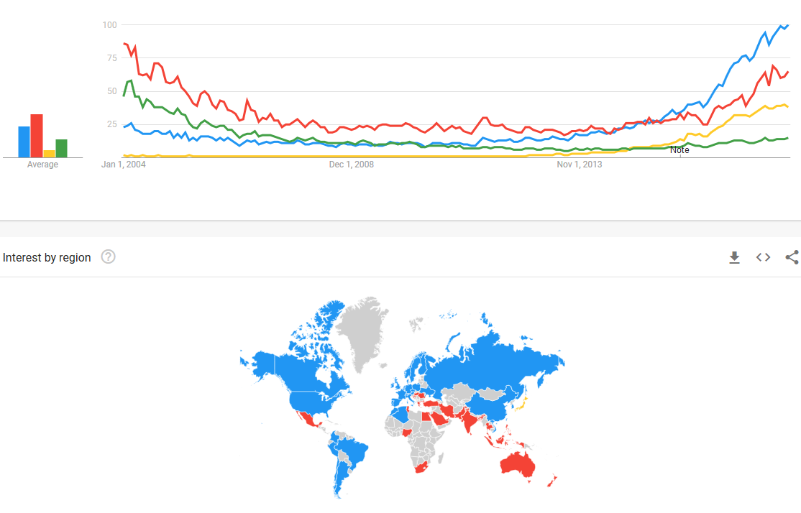
ML (blue) vs AI (red) vs DL (yellow) vs NN (green)
From Google trends

Slide 41
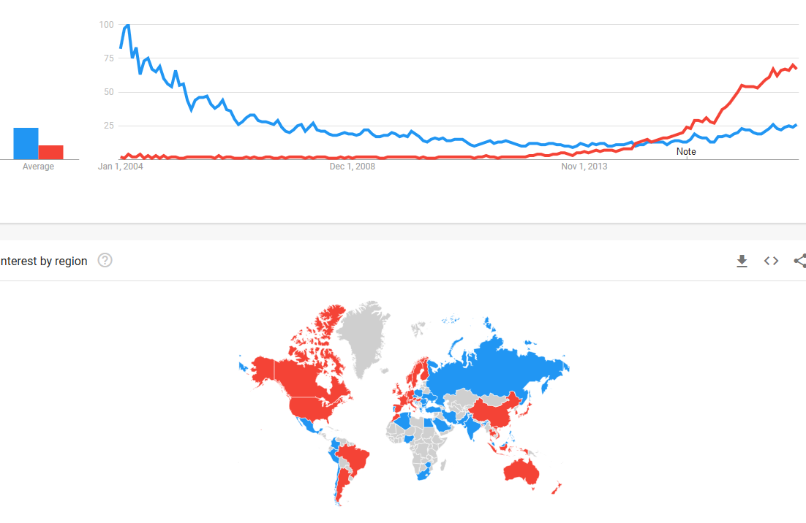
Deep learning (red) vs NN
From Google trends

Slide 42
References
Cios, K.J., Pedrycz, W., and Swiniarski, R. 1998. Data Mining Methods for Knowledge Discovery. Kluwer
Han, J., and Kamber, M. 2006. Data Mining: Concepts and Techniques. Morgan Kaufmann
Hand, D., Mannila, H., and Smyth, P. 2001. Principles of Data Mining. MIT Press
Hastie, T., Tibshirani, R., and Friedman, J. 2001. The Elements of Statistical Learning: Data Mining, Inference and Prediction. Springer
Kecman, V. 2001. Learning and Soft Computing. MIT Press
Witten, H., and Frank, E. 2005. Data Mining: Practical Machine Learning Tools and Techniques, Morgan Kaufmann
© 2007 Cios / Pedrycz / Swiniarski / Kurgan

